Slide 2
The Flow of Food
To keep food safe throughout the flow of food:
Prevent cross-contamination
Prevent time-temperature abuse
4-2
Notes:
Instructor Notes
You are responsible for the safety of the food at every point in this flow. For example, a frozen food might be safe when it leaves the processor’s plant. However, on the way to the supplier’s warehouse, the food might thaw. Once in your operation, the food might not be stored correctly, or it might not be cooked to the correct internal temperature. These mistakes can add up and cause a foodborne illness.

Slide 3
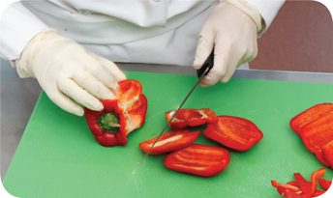
Preventing Cross-Contamination
Separate equipment:
Use separate equipment for each type of food
Clean and sanitize:
Clean and sanitize all work surfaces, equipment, and utensils after each task
4-3
Notes:
Instructor Notes
Each type of food should have separate equipment. For example, use one set of cutting boards, utensils, and containers for raw poultry. Use another set for raw meat. Use a third set for produce. Colored cutting boards and utensil handles can help keep equipment separate. The color tells food handlers which equipment to use with each food item. You might use yellow for raw chicken, red for raw meat, and green for produce, as the prep chef is doing in the photo.
Clean and sanitize all work surfaces, equipment, and utensils after each task. When you cut up raw chicken, for example, you cannot get by with just rinsing the equipment. Pathogens such as Nontyphoidal Salmonella can contaminate food through cross-contamination. To prevent this, you must wash, rinse, and sanitize equipment.

Slide 4
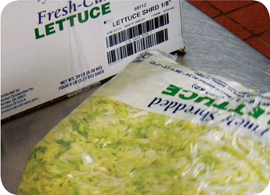
Preventing Cross-Contamination
Prep food at different times:
Prepare raw meat, fish, and poultry at different times than ready-to-eat food (when using the same prep table)
Buy prepared food:
Buy food items that do not require much prepping or handling
4-4
Notes:
Instructor Notes
If you need to use the same table to prep different types of food, prep raw meat, fish, and poultry at a different time from when prepping ready-to-eat food. You must clean and sanitize work surfaces and utensils between each type of food. For example, by prepping ready-to-eat food before raw food, you can minimize the chance for cross-contamination.
Buy food that doesn’t require much prepping or handling. For example, you could buy precooked chicken breasts or chopped lettuce, as shown in the photo.

Slide 5
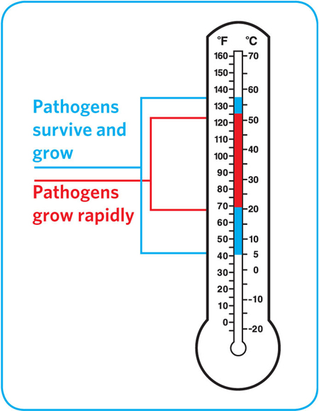
Preventing Time-Temperature Abuse
Time-temperature control:
Food held in the range of 41ºF to 135ºF (5ºC to 57ºC) has been time-temperature abused
Food has been time-temperature abused whenever it is handled in the following ways:
Cooked to the wrong internal temperature
Held at the wrong temperature
Cooked or reheated incorrectly
4-5
Notes:
Instructor Notes
Most foodborne illnesses happen because TCS food has been time-temperature abused. Remember: TCS food has been time-temperature abused any time it remains between 41ºF and 135ºF (5ºC and 57ºC). This is called the temperature danger zone because pathogens grow in this range. But most pathogens grow much faster between 70ºF and 125ºF (21ºC and 52ºC).
Food is being temperature abused whenever it is handled in the following ways: cooked to the wrong internal temperature, held at the wrong temperature, or cooled or reheated incorrectly.
The longer food stays in the temperature danger zone, the more time pathogens have to grow. To keep food safe, you must reduce the time it spends in this temperature range. If food is held in this range for four or more hours, you must throw it out.

Slide 6
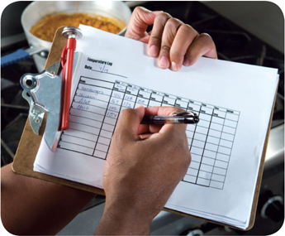
Preventing Time-Temperature Abuse
Avoid time-temperature abuse:
Monitor time and temperature
Make sure the correct kinds of thermometers are available
Regularly record temperatures and the times they are taken
Minimize the time that food spends in the temperature danger zone
Take corrective actions if time-temperature standards are not met
4-6
Notes:
Instructor Notes
Learn which food items should be checked, how often, and by whom.
Use timers in prep areas to check how long food is in the temperature danger zone.
A policy limiting the amount of food that can be removed from a cooler when prepping it can limit the time food spends in the temperature danger zone.
Reheating soup that was being held below 135ºF (57ºC) is an example of a corrective action.

Slide 7
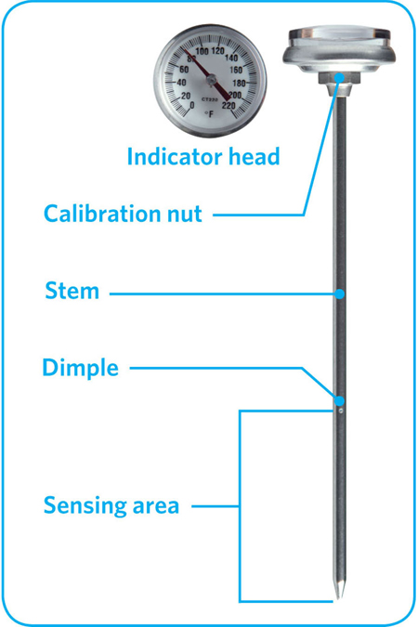
Monitoring Time and Temperature
Bimetallic stemmed thermometers
4-7
Notes:
Instructor Notes
A bimetallic stemmed thermometer can check temperatures from 0˚F to 220˚F (–18˚C to 104˚C).
This thermometer measures temperature through its metal stem. When checking temperatures, insert the stem into the food up to the dimple. You must do this because the sensing area of the thermometer goes from the tip of the stem to the dimple. This trait makes this thermometer useful for checking the temperature of large or thick food. It is usually not practical for thin food, such as hamburger patties.
The calibration nut is used to adjust the thermometer to make it accurate.

Slide 8
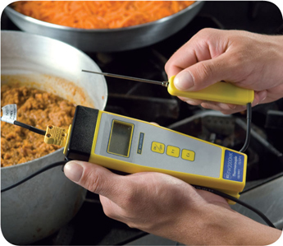
Monitoring Time and Temperature
Thermocouples and thermistors:
Measure temperature through a metal probe
Display temperatures digitally
Come with interchangeable probes
Immersion probe
Surface probe
Penetration probe
Air probe
Have a sensing area on the tip of their probes
4-8
Notes:
Instructor Notes
The sensing area on thermocouples and thermistors is on the tip of their probes. This means you don’t have to insert them into the food as far as bimetallic stemmed thermometers to get a correct reading. Thermocouples and thermistors are good for checking the temperature of both thick and thin food.
Thermocouples and thermistors come in several styles and sizes. Many come with different types of probes.
Immersion probes are used to check the temperature of liquids such as soups, sauces, and frying oil.
Surface probes are used to check the temperature of flat cooking equipment such as griddles.
Penetration probes are used to check the internal temperature of food. Small-diameter probes should be used to check the internal temperature of thin food such as meat patties and fish fillets.
Air probes are used to check the temperature inside coolers and ovens.
.

Slide 9
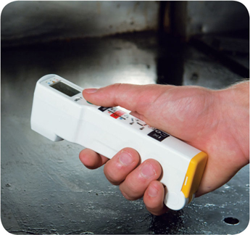
Monitoring Time and Temperature
Infrared (laser) thermometers:
Use them to measure the surface temperature of food and equipment
Hold them as close to the food or equipment as possible
Remove anything between the thermometer and the food, food package, or equipment
Follow the manufacturer’s guidelines
4-9
Notes:
Instructor Notes
These thermometers cannot measure air temperature or the internal temperature of food.
Hold the thermometer as close as possible to the food, food package, or equipment without touching it. Do NOT take readings through glass or metal, such as stainless steel or aluminum.
Always follow the manufacturer’s guidelines for the thermometer that you are using. This should give you the most accurate readings.

Slide 10
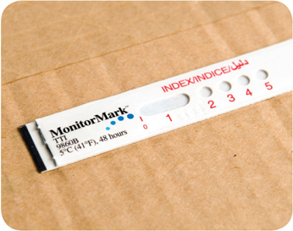
Monitoring Time and Temperature
Time-temperature indicators (TTI):
Monitor both time and temperature
Are attached to packages by the supplier
A color change appears on the device when time-temperature abuse has occurred
Maximum registering thermometer:
Indicates the highest temperature reached during use
Used where temperature readings cannot be continuously observed
4-10
Notes:
Instructor Notes
Some devices monitor both time and temperature. The time-temperature indicator (TTI) is an example. These tags are attached to packaging by the supplier. A color change appears in the window if the food has been time-temperature abused during shipment or storage. This color change is not reversible, so you know if the food has been abused.
Some suppliers place temperature-recording devices inside their delivery trucks. These devices constantly check and record temperatures. You can check the device during receiving to make sure food was at safe temperatures while it was being shipped.
Other tools are available that can help you monitor temperature. A maximum registering thermometer is one type. This thermometer indicates the highest temperature reached during use and is used where temperature readings cannot be continuously observed. It works well for checking final rinse temperatures of dishwashing machines.

Slide 11
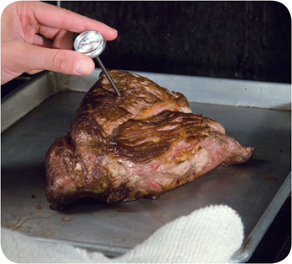
General Thermometer Guidelines
When using thermometers:
Wash, rinse, sanitize, and air-dry thermometers before and after using them
Calibrate them before each shift to ensure accuracy
Make sure thermometers used to measure the temperature of food are accurate to +/- 2ºF or +/- 1ºC
Only use glass thermometers if they are enclosed in a shatterproof casing
4-11
Notes:
Instructor Notes
Thermometers should be washed, rinsed, sanitized, and air-dried before and after each use to prevent cross-contamination. Be sure the sanitizing solution you use is for food-contact surfaces.
Thermometers can lose their accuracy when they are bumped or dropped. It can also happen when they go through severe temperature change. When this happens, the thermometer must be calibrated, or adjusted, to give a correct reading. Make sure your thermometers are accurate by calibrating them regularly. You should do this before each shift. You should also do this before the first delivery arrives. Some thermometers cannot be calibrated and must be replaced. Others will need to be sent back to the manufacturer for calibration. Follow the manufacturer’s directions regarding calibration.
Glass thermometers, such as candy thermometers, can be a physical contaminant if they break. They can only be used when enclosed in a shatterproof casing.

Slide 12
General Thermometer Guidelines
When using thermometers:
Insert the thermometer stem or probe into the thickest part of the product (usually the center)
Take more than one reading in different spots
Wait for the thermometer reading to steady before recording the temperature
4-12
Notes:
Instructor Notes
When checking the temperature of food, insert the probe into the thickest part of the food, as shown in the photo. This is usually in the center. Also take another reading in a different spot. The temperature may vary in different areas. Before recording a temperature, wait for the thermometer reading to steady. Wait at least 15 seconds after you insert the stem or the probe into the food.

Slide 13
Review
Let’s review
4-13
Notes:
Instructor Notes
Use the next several slides to review the content presented.
To ensure that everyone in class participates, pass out index cards with the letters A, B, C, and D on them. Have each student answer each question by holding up the correct letter.

Slide 14
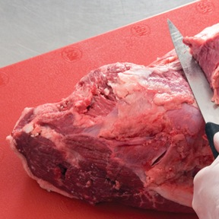
Review
Can this prevent cross-contamination? Why?
A. Yes
B. No
Prepping meat on a red cutting board
4-14
Notes:
Instructor Notes
The answer is A. Using separate equipment can help prevent cross-contamination. Colored cutting boards and utensil handles can help keep equipment separate. The color tells food handlers which equipment to use with each type of food.

Slide 15
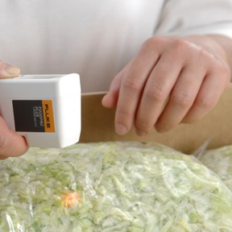
Review
Can this prevent cross-contamination? Why?
A. Yes
B. No
Buying precut lettuce for salads
4-15
Notes:
Instructor Notes
The answer is A. Buying food that doesn’t require much prepping or handling, such as precut lettuce, can help prevent cross-contamination.

Slide 16
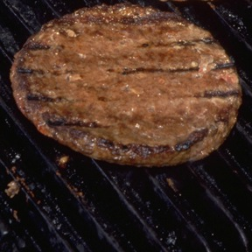
Review
Which thermometer(s) is best for measuring the temperature of this?
A. Bimetallic stemmed
B. Thermocouple
C. Infrared
Hamburger patty
4-16
Notes:
Instructor Notes
The answer is B. Thermocouples and thermistors are good for checking the temperatures of thin food because they do not need to be inserted very far into the food to get an accurate reading. Bimetallic stemmed thermometers are not practical for checking the temperature of thin food, such as hamburger patties. That’s because they have to be inserted into the food from the tip of the stem to the sensing area.

Slide 17
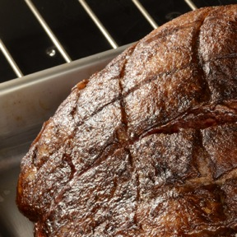
Review
Which thermometer(s) is best for measuring the temperature of this?
A. Bimetallic stemmed
B. Thermocouple
C. Infrared
Roast
4-17
Notes:
Instructor Notes
The answers are A and B. Bimetallic stemmed thermometers are good for checking the temperature of large or thick food, like this roast. Thermocouples and thermistors are good for checking the temperature of thick and thin food. An infrared thermometer is not a good choice because it can only check the surface temperature of the product.

Slide 18
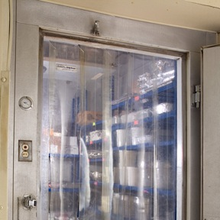
Review
Which thermocouple probe should be used when measuring temperature in this situation?
A. Immersion probe
B. Surface probe
C. Penetration probe
D. Air probe
Cooler temperature
4-18
Notes:
Instructor Notes
The answer is D. An air probe is good for checking the temperature inside coolers and ovens.

Slide 19
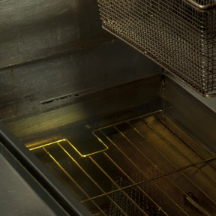
Review
Which thermocouple probe should be used when measuring temperature in this situation?
A. Immersion probe
B. Surface probe
C. Penetration probe
D. Air probe
Fryer oil
4-19
Notes:
Instructor Notes
The answer is A. Immersion probes are used to check the temperature of liquids such as soups, sauces, and frying oil.

Slide 20
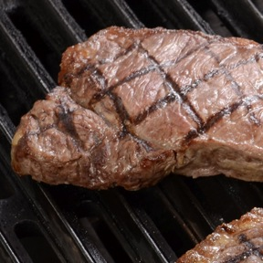
Review
Which thermocouple probe should be used when measuring temperature in this situation?
A. Immersion probe
B. Surface probe
C. Penetration probe
D. Air probe
Steak
4-20
Notes:
Instructor Notes
The answer is C. Penetration probes are used to check the internal temperature of food, such as this steak.

Slide 21
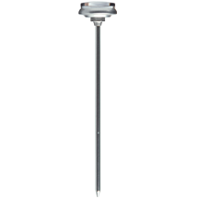
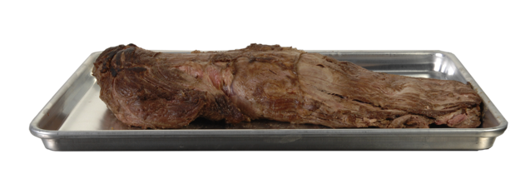
Apply Your Knowledge
Where should you stick the thermometer?
C
B
A
4-21
Notes:
Instructor Notes:
The answer is C. When checking the temperature of food, insert the probe into the thickest part of the food. This is usually the center. Also, take another reading in a different spot. The temperature may vary in different areas.

Slide 22
Activity
Stump the Trainer
4-22
Notes:
Instructor Notes
Do the Stump the Trainer activity. This activity can be downloaded from ServSafe.com. Directions for using the activity are included with it.

